Slide 1
Image classification using CNN
Machine learning major project, Bandaru Lavadeep

Slide 2
Image classification
Image classification is a fundamental task in computer vision where machines are trained to recognize and categorize the content of images to identify and assign labels to objects or patterns within images.
APPLICATIONS:
Object Recognition
Medical Imaging
Autonomous Vehicles
Security And Surveillance
E-Commerce
Agriculture
Environmental Monitoring
Quality control in Manufacturing

Slide 3
Objective of the project
The objective of this project is to develop a Convolutional Neural Network (CNN) Model for image classification using a large labeled dataset.
This model is got trained by using the CIFAR-10 dataset and classifies images into one of 10 predefined classes.

Slide 4
Dataset
I have used “CIFAR-10” dataset to train my model which has 10 different classes of images.
It has a total of 60,000 images in which, 50,000 are used for training the model and rest of 10,000 were for testing.
The images are of very small size 32×32 and the resolution of the images is also low, which effects the model.

Slide 5
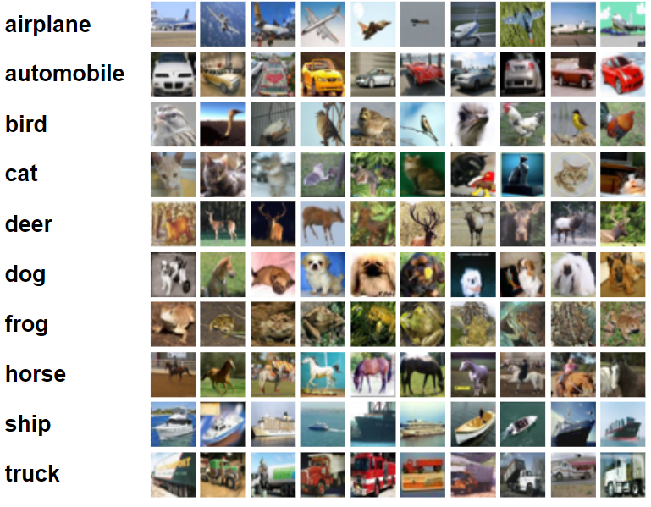
The classes are:
Airplane
Automobile
Bird
Cat
Deer
Dog
Frog
Horse
Ship
Truck

Slide 6
Preprocessing of the data
Normalization:
Why Normalize?
Ensures consistent scales for features.
Facilitates faster convergence during model training.
How?
Scaling pixel values of images to a range of [0, 1].
Standardizing features to have a mean of 0 and a standard deviation of 1.
One-Hot Encoding:
What is it?
Transforming categorical labels into binary vectors.
Each class gets a unique binary representation.
Why Use?
Enables the model to interpret and output categorical predictions.
Essential for multi-class classification tasks.
Data Augmentation:
Purpose:
Introduces variability into the dataset by applying random transformations to the images.
Mitigates overfitting by expanding the diversity of the training set.
Transformations:
Random rotations, shifts, flips, and zooms.
Enhances model robustness to variations in real-world data.

Slide 7
cnn architecture
Convolutional Layers:
The architecture begins with Conv2D layers, each acting as a set of learnable filters capturing spatial hierarchies and patterns in the input images.
Batch Normalization:
After each Conv2D layer, Batch Normalization is applied to stabilize and accelerate the training process by normalizing the input.
MaxPooling Layers:
Interspersed with Conv2D layers, MaxPooling layers reduce spatial dimensions, preserving essential information while enhancing computational efficiency.
Flatten Layer:
The Flatten layer transforms the 3D output of the convolutional and pooling layers into a one-dimensional array, preparing it for fully connected layers.

Slide 8
Dense Layers:
Dense layers with rectified linear unit (ReLU) activation follow, extracting high-level features and patterns.
Batch Normalization and Dropout:
Batch Normalization is employed in the Dense layers to further stabilize training, and Dropout is applied to prevent overfitting.
Output Layer:
The final layer, with softmax activation, produces class probabilities, making it suitable for multi-class classification
Learning Rate Schedule:
Batch Normalization is employed in the Dense layers to further stabilize training, and Dropout is applied to prevent overfitting.

Slide 9
Training process
The model got trained by 100 epochs with scheduled learning rate.
As the dataset is quite large it took nearly 2 ours to train the data.
The accuracy of the model rose to 0.8297 from 0.4231 on experimenting with learning rates and convolutional layers.

Slide 10
Evaluation metrics
“ADAM” compiler was used in this model.
For calculating loss “Categorical Crossentropy” is used for this model because it is a Multiclass Classification model.
F1 score and Recall were also calculated.
Test Accuracy : 0.8297
Test F1 Score : 0.8269
Test Recall : 0.8297

Slide 11
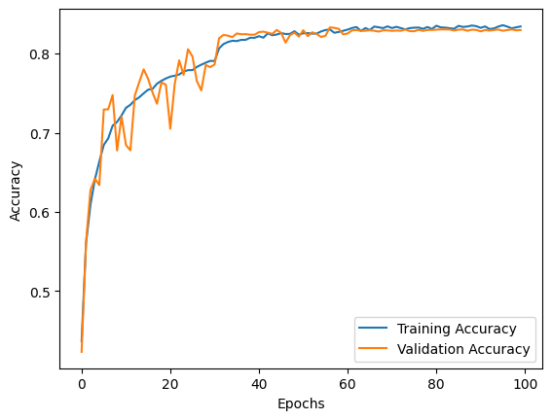
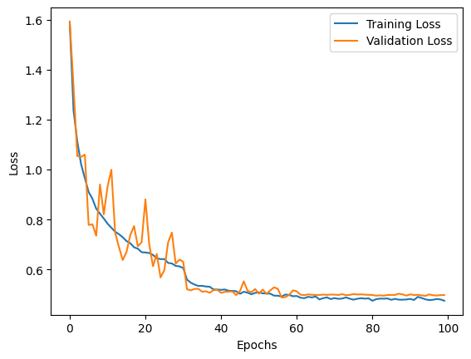
Accuracy v/s Epochs
Loss v/s Epochs

Slide 12
deployment
I have used Flask app to deploy the model and tested it.
The trained model is saved and got used in flask app.
We can use flask app by saving an image in images folder,run the app and open localhost:5678 in the browser to predict the image.

Slide 13
Challenges Faced:
The accuracy of the model is very low in the initial stages of the project as the images used for training the model and also the CNN model was quite simple
Solutions Implemented:
Data Augmentation was done to the training data to generalize the model better.
Implemented scheduled Learning rate.
Revised the CNN model by adding layers and experimented with different hyperparameters like the number of epochs to achieve maximum accuracy.

Slide 14
Thank you
-Bandaru Lavadeep

